Slide 1



YOUTUBE SONGS
ANALYSIS
By: Abdullah Farid Abdullah

Slide 2

CONTENT
01
PROBLEM STATEMENT
02
DATA CLEANING
03
DATA PREPROCESSING
04
EXPLORATORY DATA ANALYSIS
05
CONTENT AND CHANNEL ANALYSIS
06
TEMPORAL TRENDS
07
RECOMMENDATIONS

Slide 3




PROBLEM STATEMENT
The goal is to utilize Power BI to create insightful visualizations and reports that provide a deeper understanding of YouTube songs' performance, popularity, and user engagement.
The analysis aims to uncover trends, preferences, and patterns in the data to aid content creators and stakeholders in optimizing their YouTube song content.

Slide 4
DATASET COLUMNS
video_id
channelTitle
title
description
Unique identifier for each YouTube video
Title of the YouTube channel publishing the song.
Title of the Youtube song video
Description provided for the YouTube song video
tags
publishedAt
viewCount
likeCount
Tags associated with the YouTube song video
Date and time when the YouTube song video was published
Date and time when the YouTube song video was published
Number of likes received by the YouTube song video
favoriteCount
commentCount
duration
definition
Number of times the YouTube song video has been marked as a favorite
Number of comments posted on the YouTube song video
Duration of the YouTube song video
Video definition or quality (e.g., HD, SD)
captions
Availability of captions for the YouTube song video

Slide 5

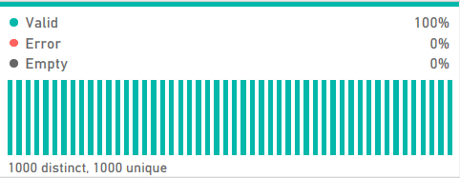
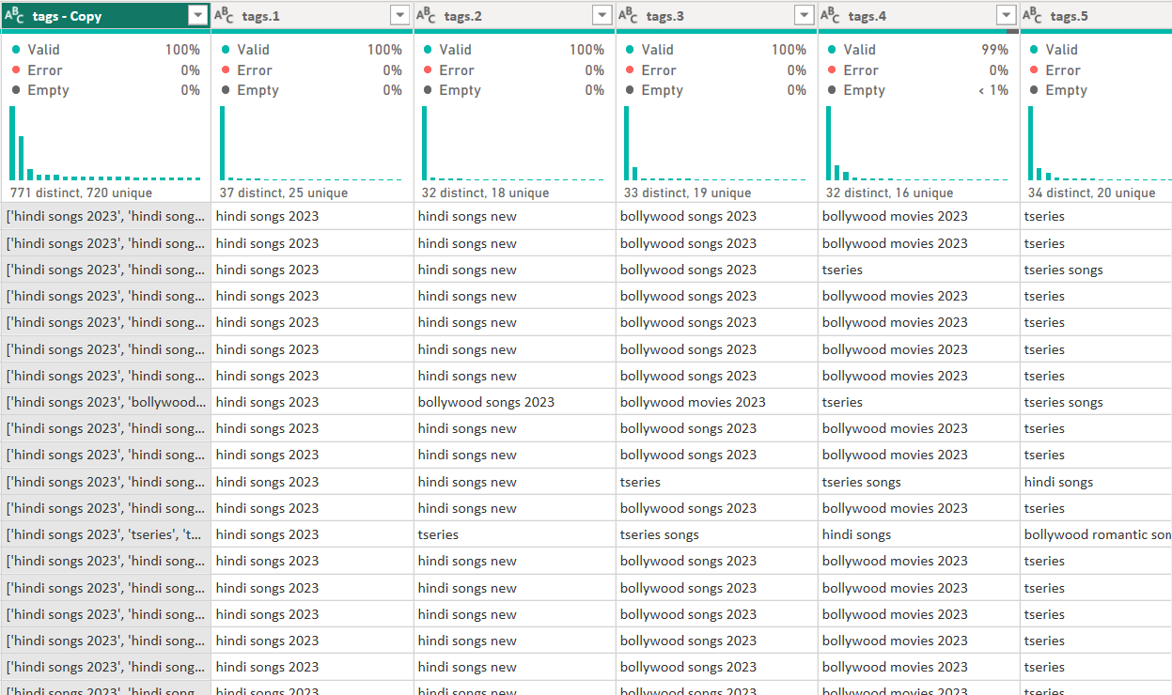
DATA CLEANING
Convert relevant columns to appropriate data types.
Removed Duplicates in song titles
Cleaned the tags column from commas and parenthesis and splitted the column to see different tags

Slide 6
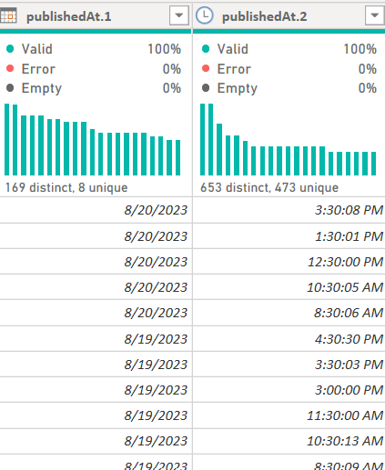
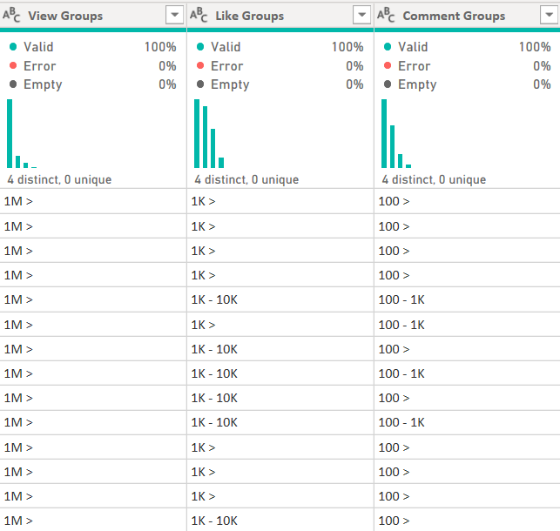
DATA PREPROCESSING
Splitted the publishedAt column to a have a date column and a time column sperately.
Created three columns to represent the groups of the likeCount, commentCount, and viewCount Respectively.

Slide 7
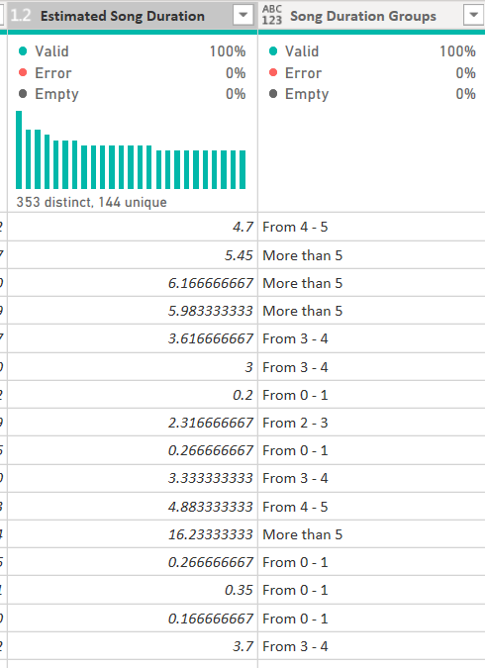
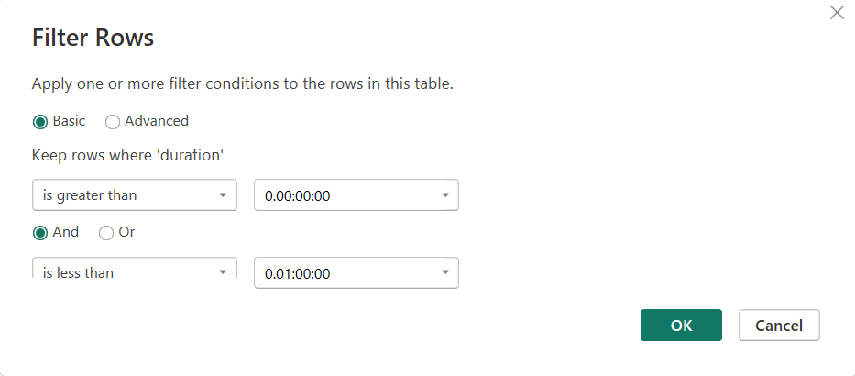
DATA PREPROCESSING
Filtered the dataset to exclude any 0 second song video or more than 1 hour song videos
Splitted the duration column into minutes and seconds then recombine them to represent the duration in a single decimal number. Created duration groups

Slide 8
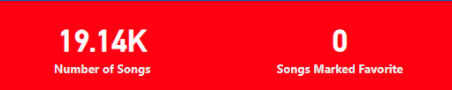
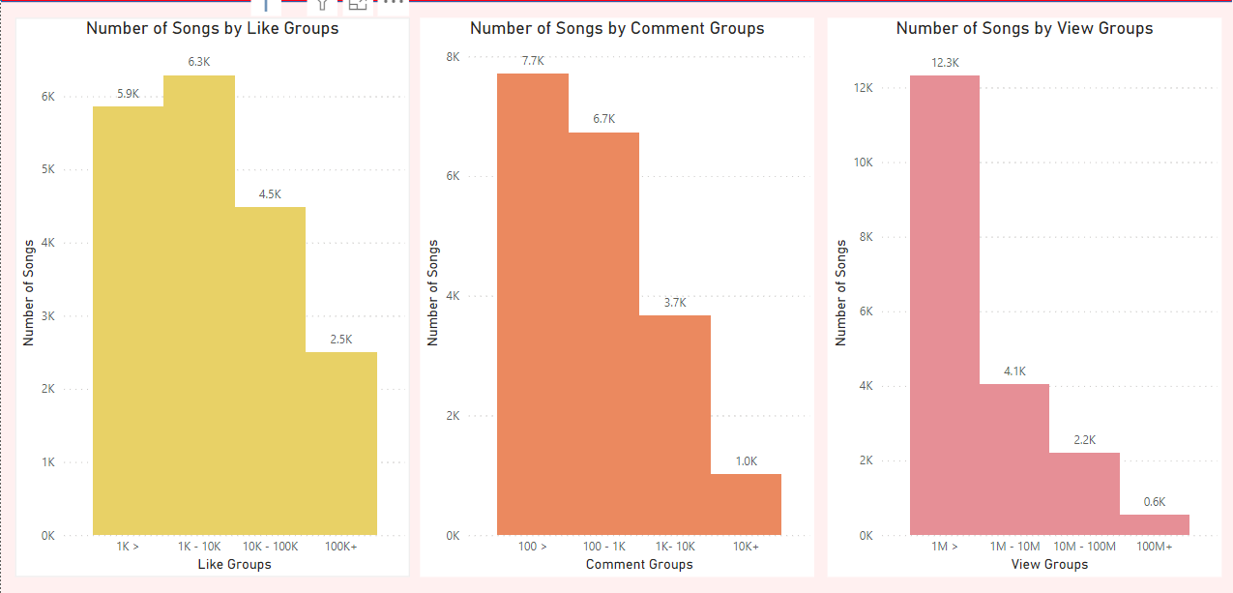
EXPLORATORY DATA ANALYSIS
Our Dataset, after removing duplicates, has 19.14K songs where none of them was marked favorite by Youtube
All 3 songs metrics show a right skewed distribution, which shows few songs with the most engagement

Slide 9
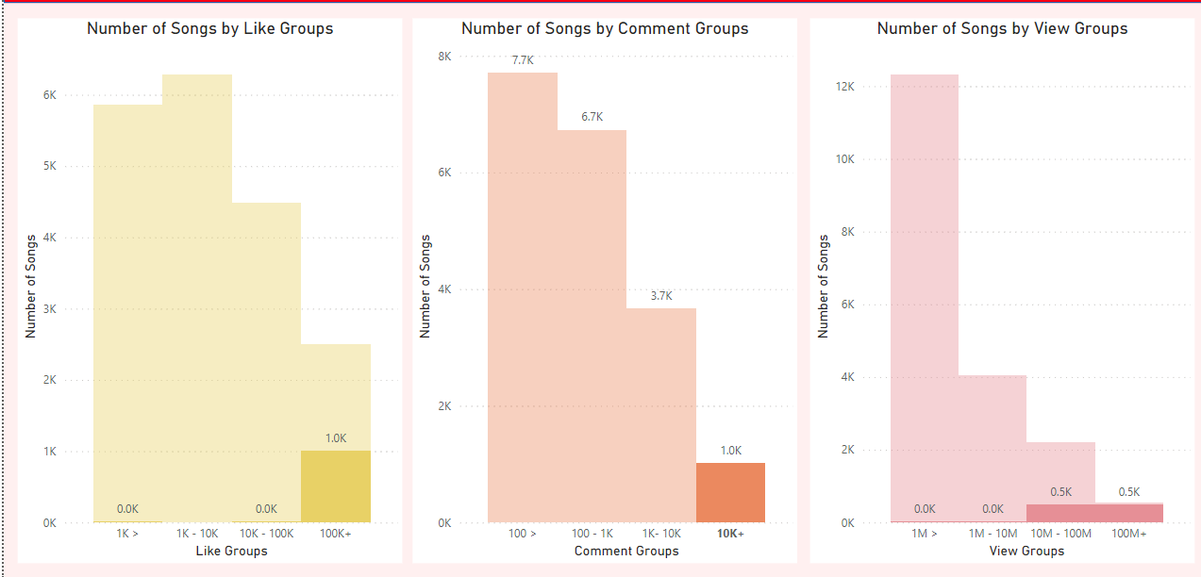

Slide 10
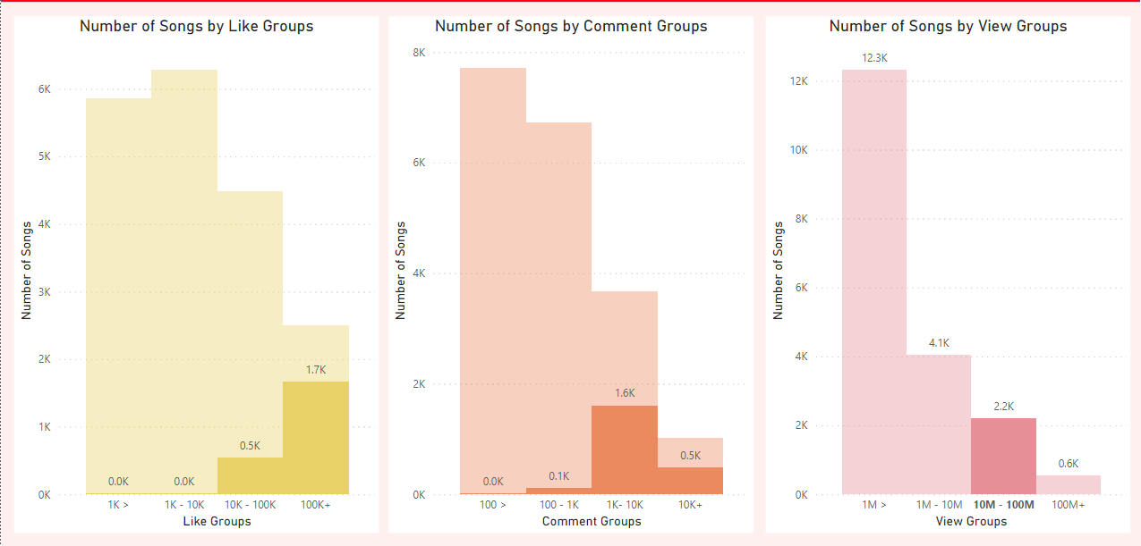

Slide 11

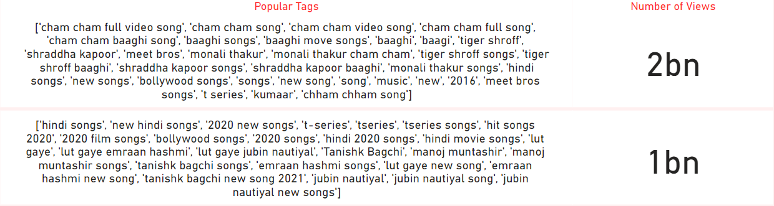
CONTENT AND CHANNEL ANALYSIS
The song videos all come from a single channel (T-series), the second most subscribed channel in the world.
Here are the most popular tags having an average of 2 billion views:

Slide 12
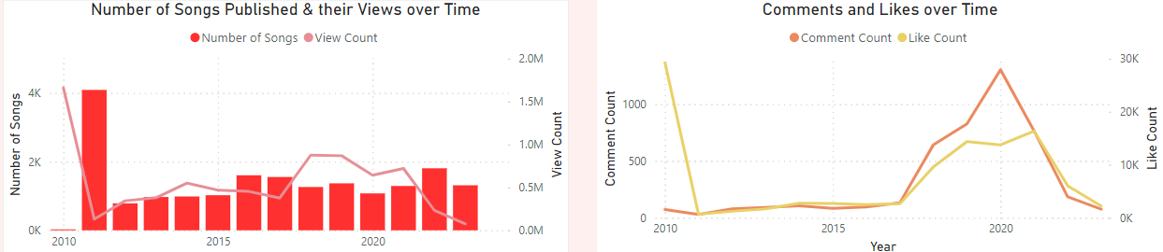
TEMPORAL ANALYSIS
Across 13 years, the relation between number of songs published and user engagement has developed a negative relationship.

Slide 13
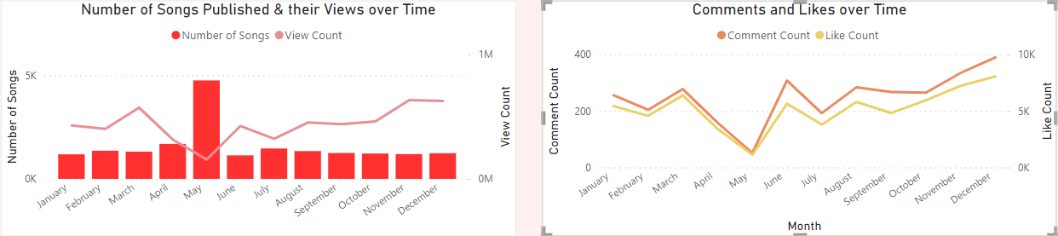
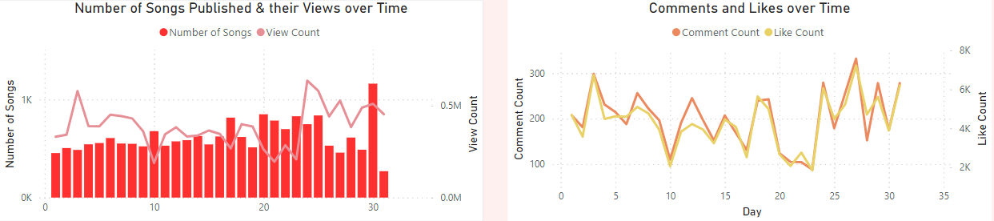

Slide 14
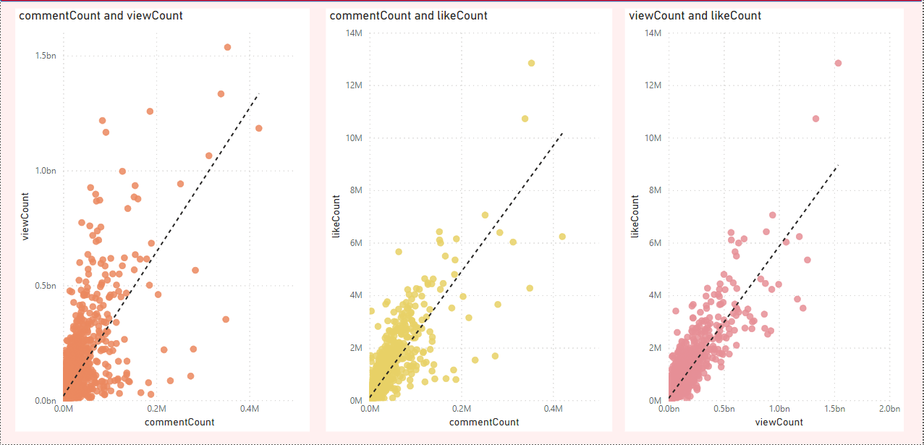
USER ENGAGEMENT INSIGHTS
Generally, there is a positive correlation between song videos metrics, the strongest being between comments and views

Slide 15
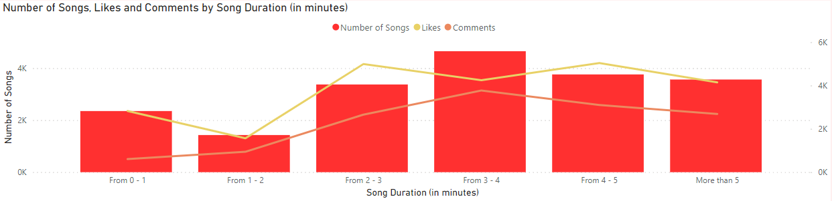
USER ENGAGEMENT INSIGHTS
Relationship between song duration and user engagement

Slide 16
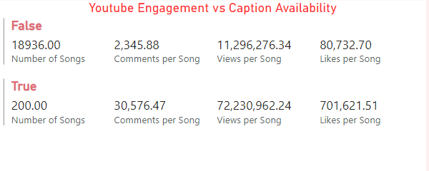
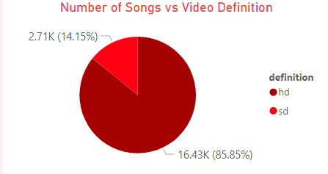
USER ENGAGEMENT INSIGHTS

Slide 17
RECOMMENDATIONS
for content creators and stakeholders to enhance YouTube song video performance

Slide 18

01
02
03
04
DURATION
CAPTIONS
UPLOAD DATE & TIME
TAGS
Songs that lasts from 2 to 4 minutes have the most user engagement.
Enabling / Providing captions tend to increase user engagement as it open doors to users with different cultures
Uploading a video at the end year / at the end of the month tend to have more engagement. It can be due special content that the channel uploads
General tags such as: “new songs”, “t-series” and popular tag trends such as “cham cham song” tend to have more engagement

Slide 19

THANKS FOR WATCHING

